Slide 1
OOP CONCEPTS
TEAM 2

Slide 2
CONTENT
Introduction
Inheritance
Polymorphism
Abstraction
Encapsulation
Classes and Objects
Defining Methods
Constructors and Initialization
Static Data Members and Methods
Reference Variable Casting
Abstract Classes and Interfaces

Slide 3
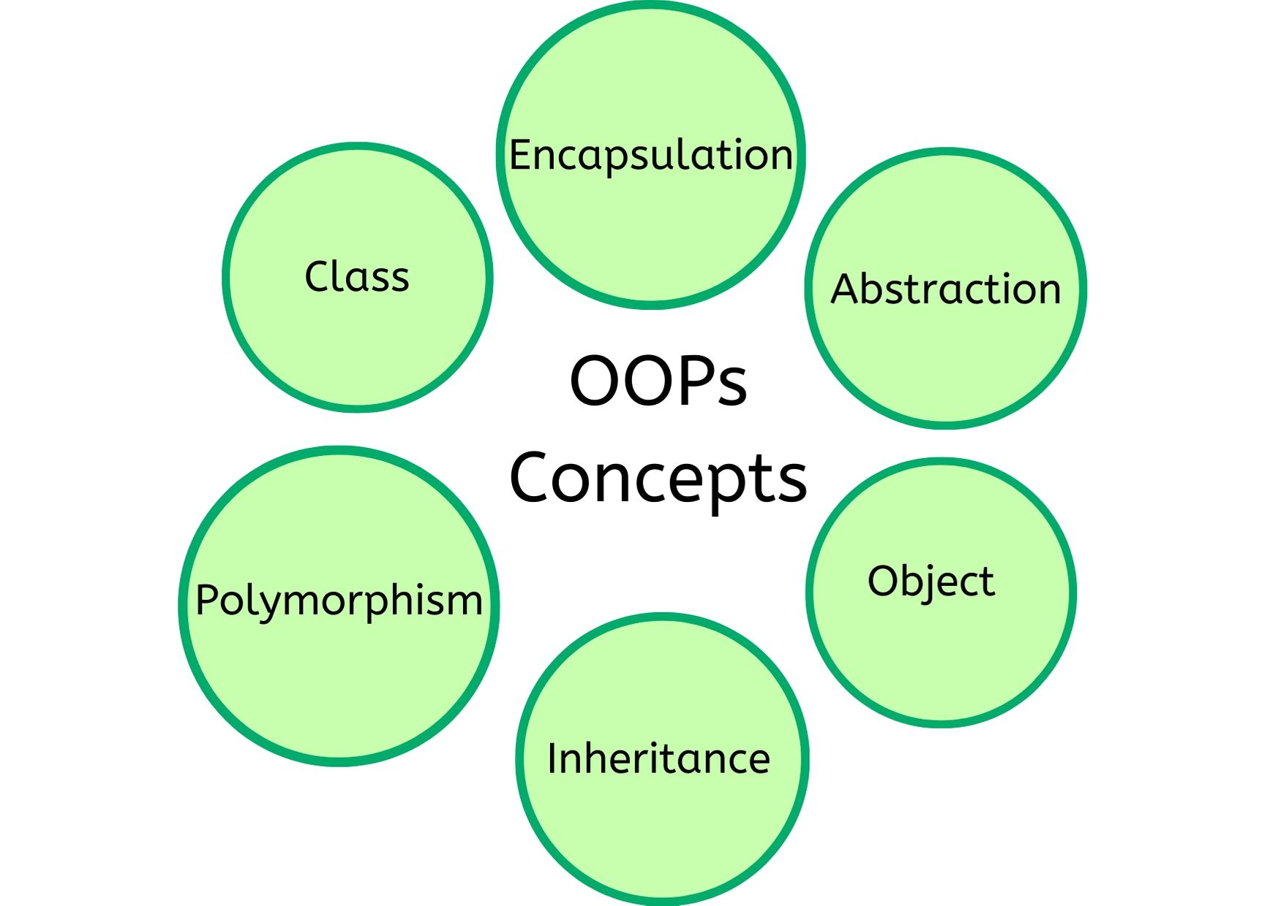
INTRODUCTION
Object-oriented programming aims to implement real-world entities like inheritance, hiding, polymorphism, objects etc. in programming.

Slide 4
WHY WE NEED OBJECT ORIENTED PROGRAMMING?
To get a clear structure for the programs.
To keep the Java code DRY.
To create full reusable applications.

Slide 5
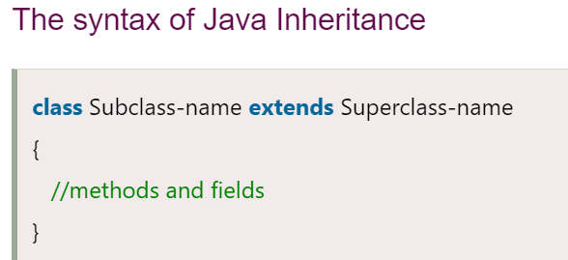
INHERITANCE
When one object acquires all the properties and behaviors of a parent object, it is known as inheritance. It provides code reusability.
Inheritance represents the IS-A relationship which is also known as a parent-child relationship. Which means, when you inherit from an existing class, you can reuse methods and fields of the parent class. Moreover, you can add new methods and fields in your current class also.

Slide 6
Terms used in Inheritance
Class: A class is a group of objects which have common properties. It is a template or blueprint from which objects are created.
Sub Class/Child Class: Subclass is a class which inherits the other class. It is also called a derived class, extended class, or child class.
Super Class/Parent Class: Superclass is the class from where a subclass inherits the features. It is also called a base class or a parent class.
Reusability: As the name specifies, reusability is a mechanism which facilitates you to reuse the fields and methods of the existing class when you create a new class. You can use the same fields and methods already defined in the previous class.

Slide 7
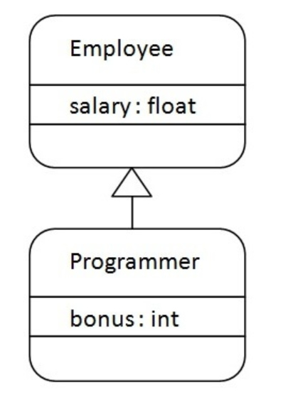
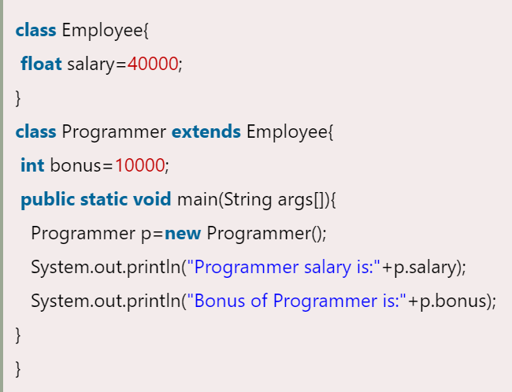
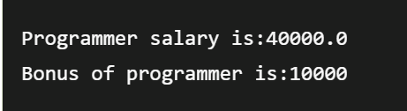
Java Inheritance Example
As displayed in the above figure, Programmer is the subclass and Employee is the superclass. The relationship between the two classes is Programmer IS-A Employee. It means that Programmer is a type of Employee.

Slide 8
Types of Inheritance
On the basis of class, there can be three types of inheritance in java: single, multilevel and hierarchical.
Single Inheritance:
When a class inherits another class, it is known as a single inheritance.
Multilevel Inheritance:
When there is a chain of inheritance, it is known as multilevel inheritance.
Hierarchical Inheritance
When two or more classes inherits a single class, it is known as hierarchical inheritance.

Slide 9
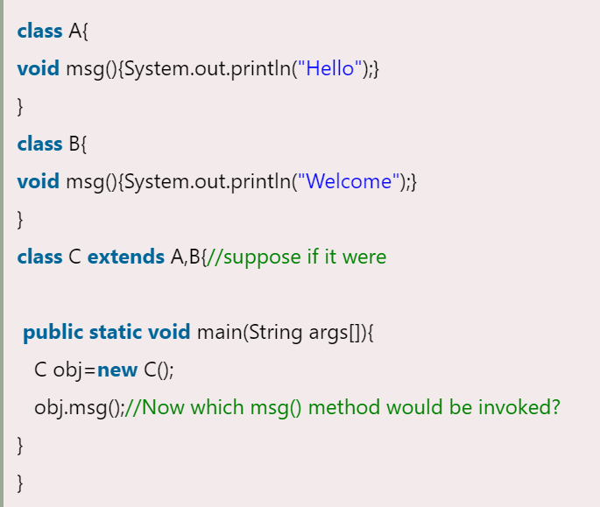

Why multiple inheritance is not supported in java?
To reduce the complexity and simplify the language, multiple inheritance is not supported in java.
Consider a scenario where A, B, and C are three classes. The C class inherits A and B classes. If A and B classes have the same method and you call it from child class object, there will be ambiguity to call the method of A or B class.
Since compile-time errors are better than runtime errors, Java renders compile-time error if you inherit 2 classes. So, whether you have same method or different, there will be compile time error.

Slide 10
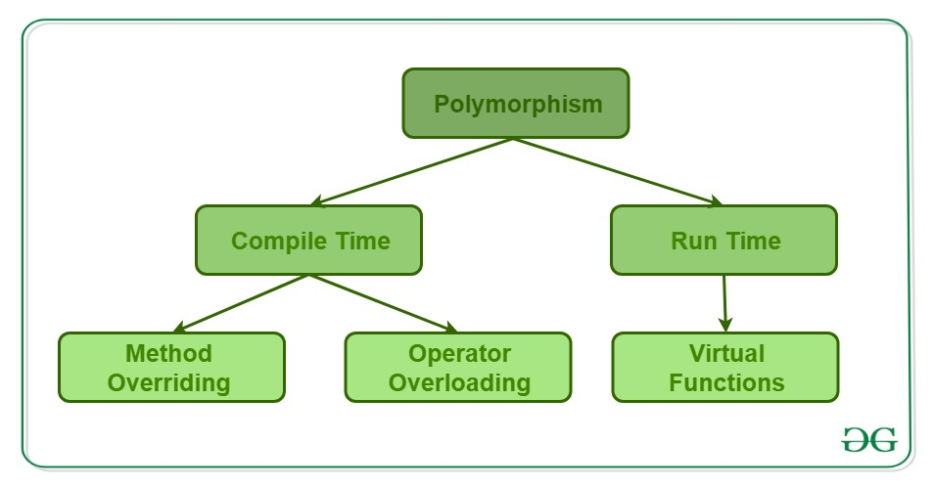
POLYMORPHISM
Polymorphism in Java is a concept by which we can perform a single action in different ways. The word "poly" means many and "morphs" means forms. So, polymorphism means many forms.
There are two types of polymorphism in Java: compile-time polymorphism and runtime polymorphism
We can perform polymorphism in java by method overloading and method overriding.

Slide 11
Compile time polymorphism Vs. Runtime polymorphism or Dynamic Method Dispatch
In Compile time Polymorphism, the call is resolved by the compiler.
Method overloading is the compile-time polymorphism where more than one methods share the same name with different parameters or signature and different return type.
Run time Polymorphism is a process in which a call to an overridden method is resolved at runtime rather than compile-time.
Method overriding is the runtime polymorphism having same method with same parameters or signature, but associated in different classes
In this process, an overridden method is called through the reference variable of a superclass.

Slide 12
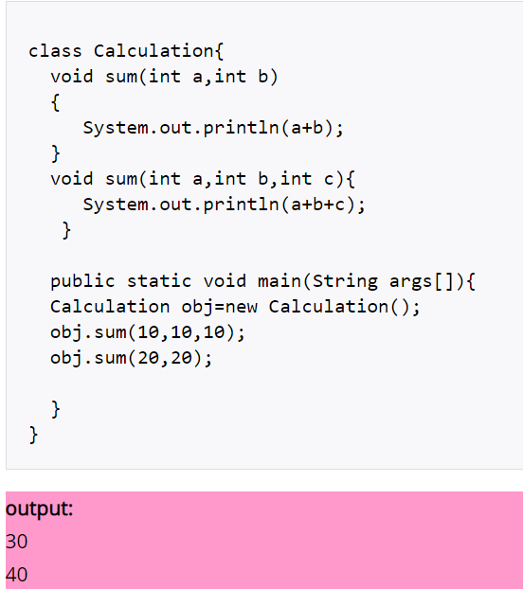
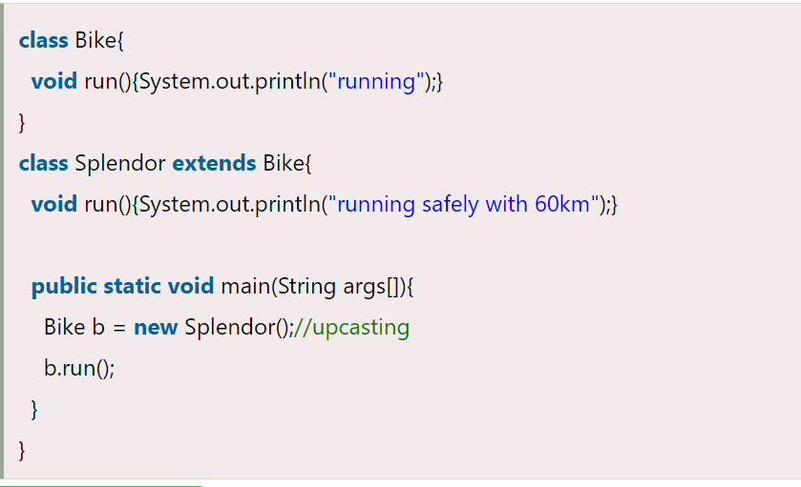

Example of Compile time Polymorphism By changing number of arguments:
Runtime Polymorphism Example:

Slide 13
ABSTRACTION
Data abstraction refers to providing only essential information about the data to the outside world, hiding the background details or implementation.
Avoids code duplication and increases reusability.
Helps in to increase security of an application or program as only important details are provided to the user.

Slide 14

REAL LIFE EXAMPLE OF ABSTRACTION

Slide 15
HOW TO ACHIEVE ABSTRACTION?
There are two ways to achieve abstraction in java:
Abstract class(0-100%)
Interface (100%)

Slide 16
ENCAPSULATION
Encapsulation is a process of wrapping code and data together into a single unit.
It is a way to achieve data hiding.
It increases flexibility

Slide 17
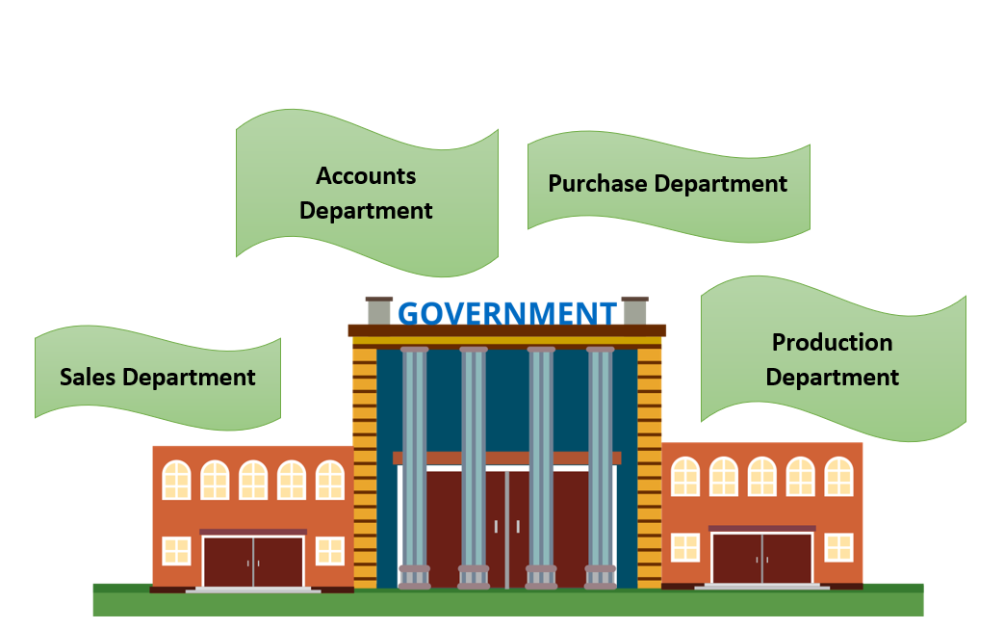
ENCAPSULATION REAL LIFE EXAMPLE

Slide 18
HOW TO ACHIEVE ENCAPSULATION ?
To achieve encapsulation in Java :
Declare the variables of a class as private.
Provide public setter and getter methods to modify and view the variables values.

Slide 19
CLASSES AND INSTANCES
Java is an object-oriented programming language.
Everything in Java is associated with classes and objects.
A class is a user defined blueprint or prototype from which objects are created.
It represents the set of properties and methods that are common to all objects of one type.

Slide 20
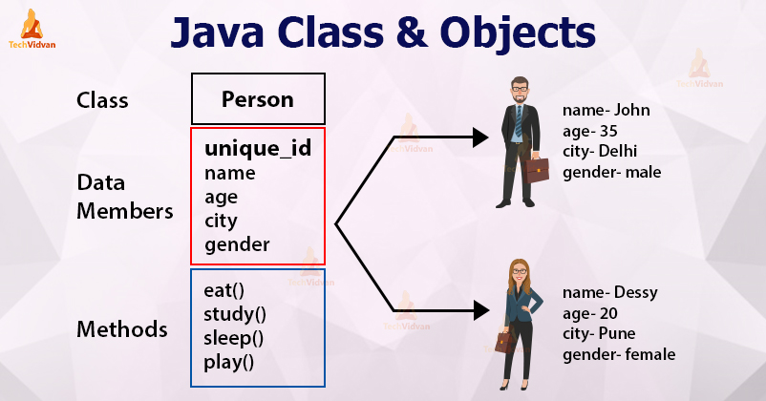
A REAL-LIFE EXAMPLE: unique_id -001 unique_id -002

Slide 21
CLASS DECLARATION
Modifiers: A class can be public or has default access.
class keyword: class keyword is used to create a class.
Class name: The name should begin with an initial letter (capitalized by convention).
Superclass(if any): The name of the class’s parent (superclass), if any, preceded by the keyword extends. A class can only extend (subclass) one parent.
Body: The class body surrounded by braces, { }.

Slide 22
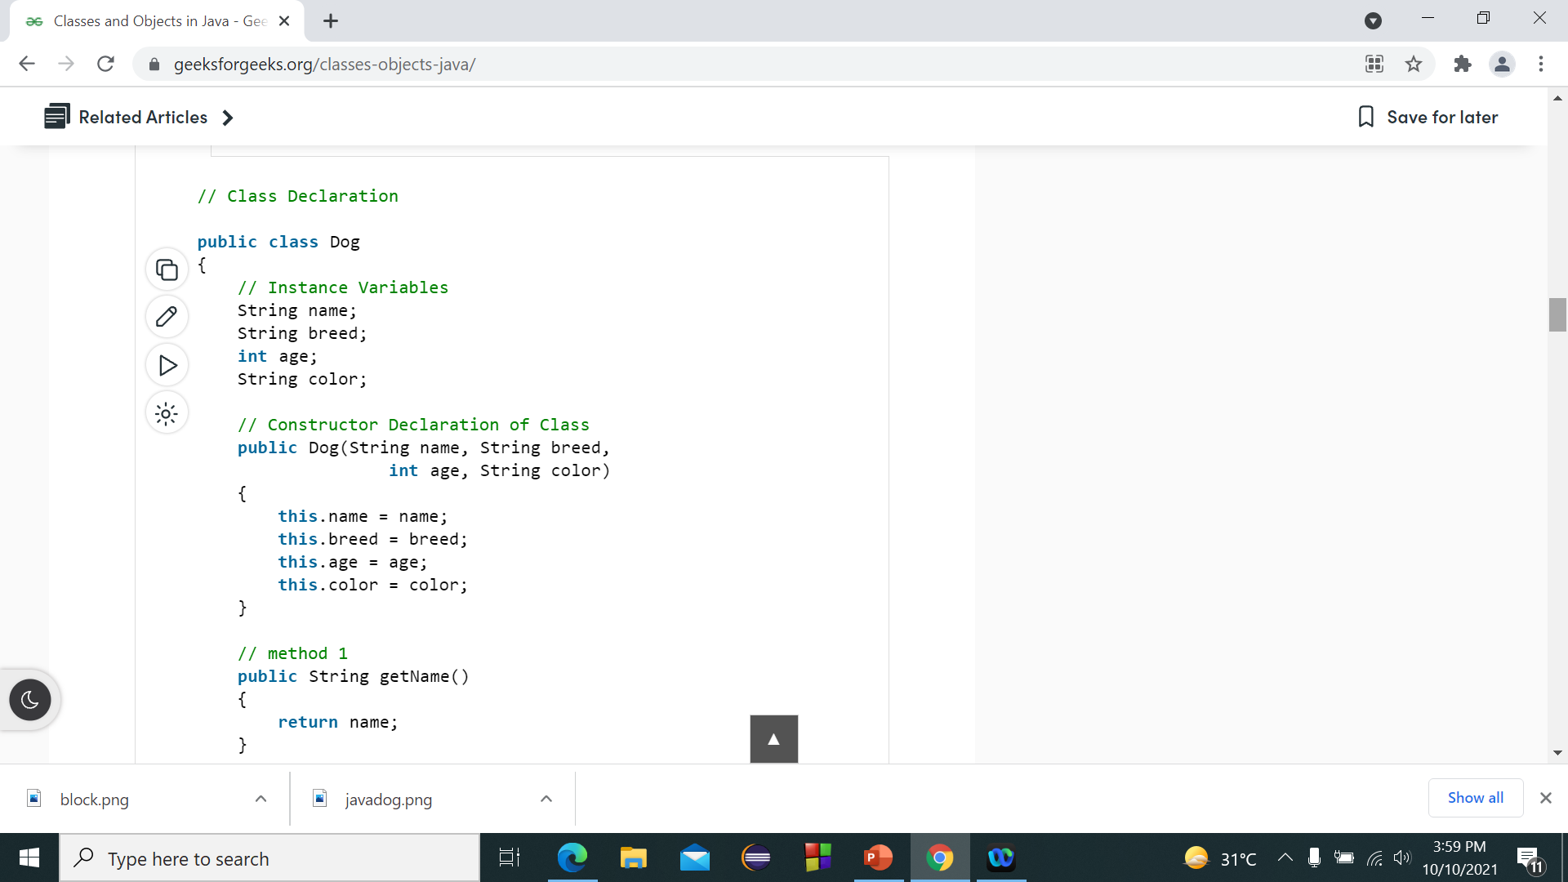
CODE EXAMPLE

Slide 23
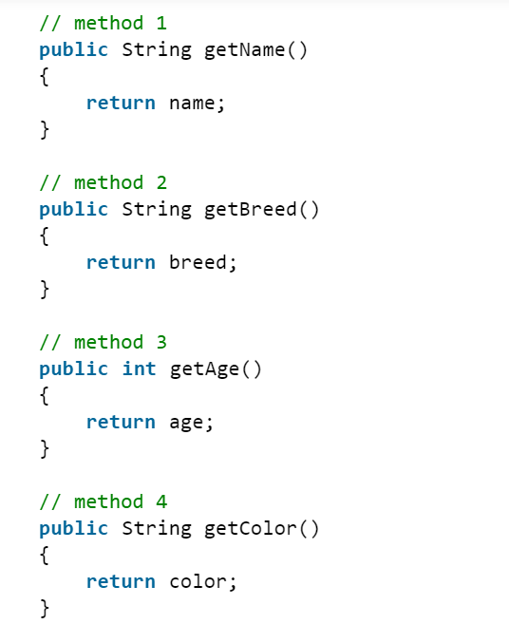
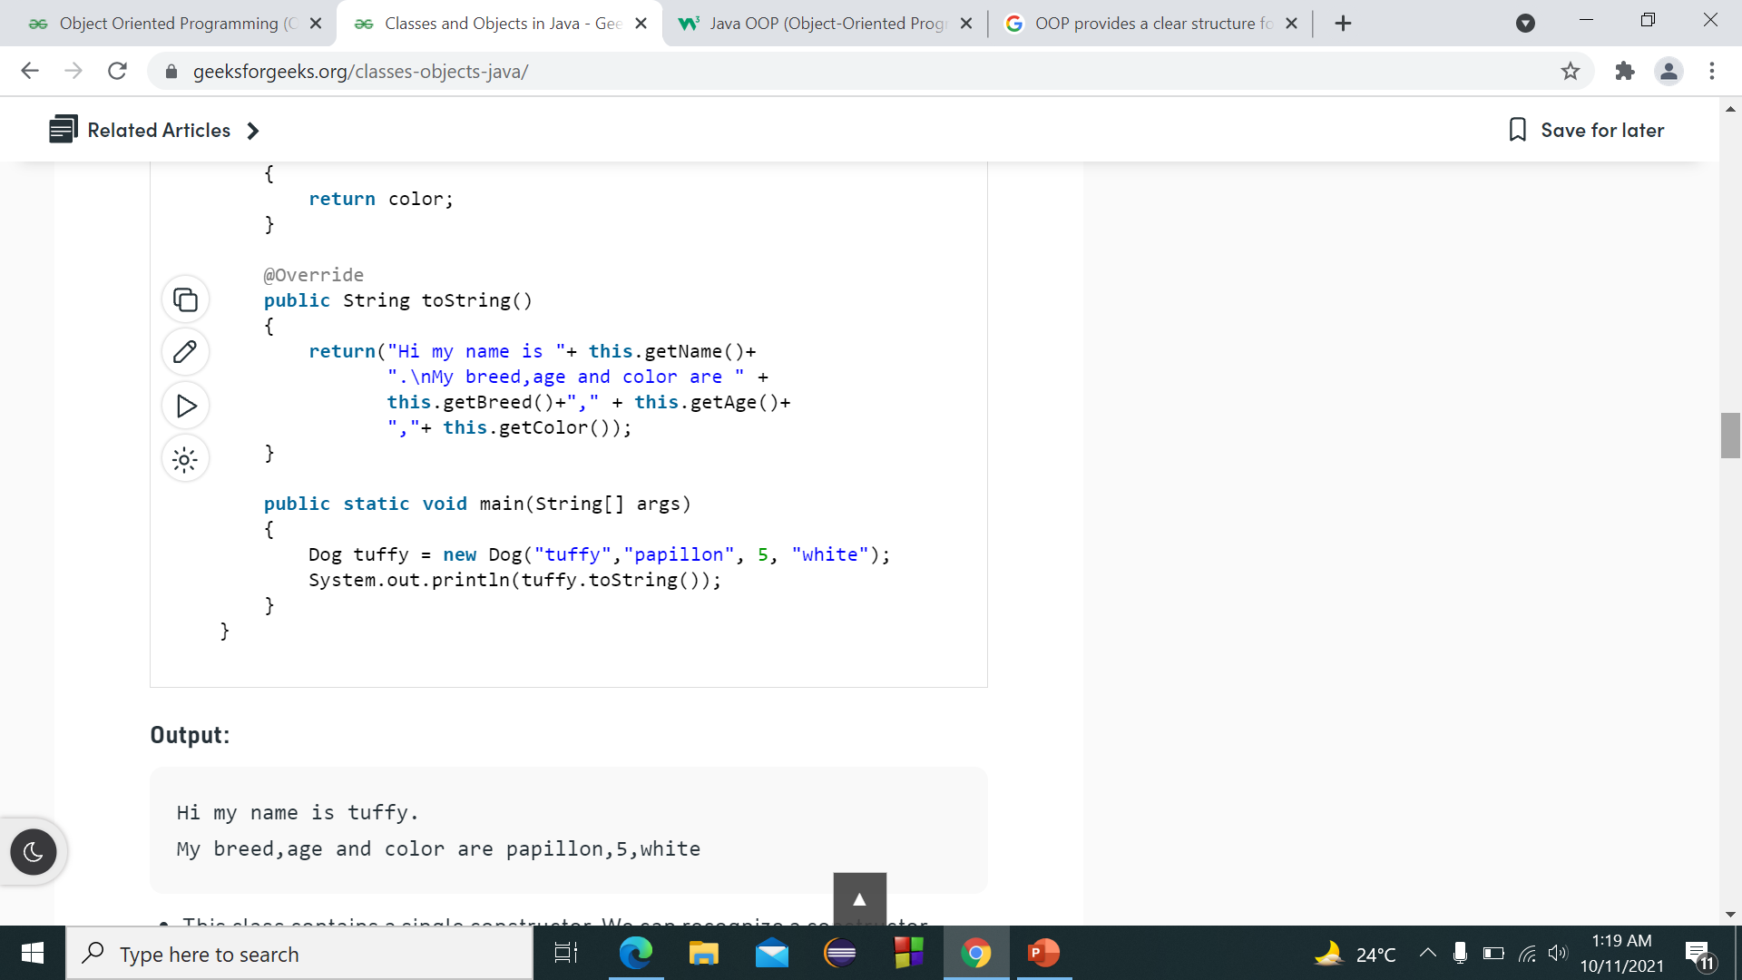
METHODS OF THE CLASS

Slide 24
OBJECT
It is a basic unit of Object-Oriented Programming. A typical Java program creates many objects, which as you know, interact by invoking methods. An object consists of :
Attributes: It is represented by attributes of an object. It also reflects the properties of an object.
Behavior: It is represented by methods of an object. It also reflects the response of an object with other objects.
Identity: It gives a unique name to an object and enables one object to interact with other objects.

Slide 25
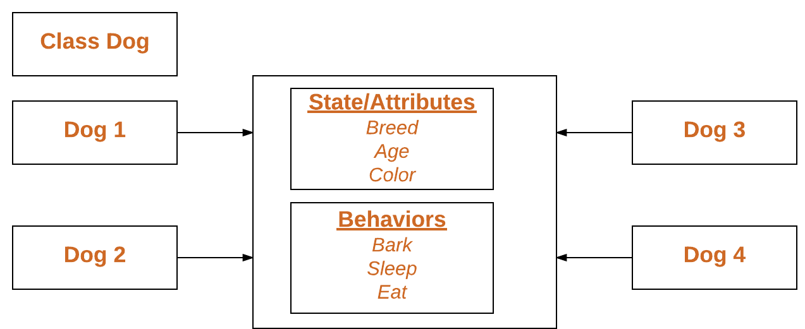
INSTANTIATION
When an object of a class is created, the class is said to be instantiated.

Slide 26
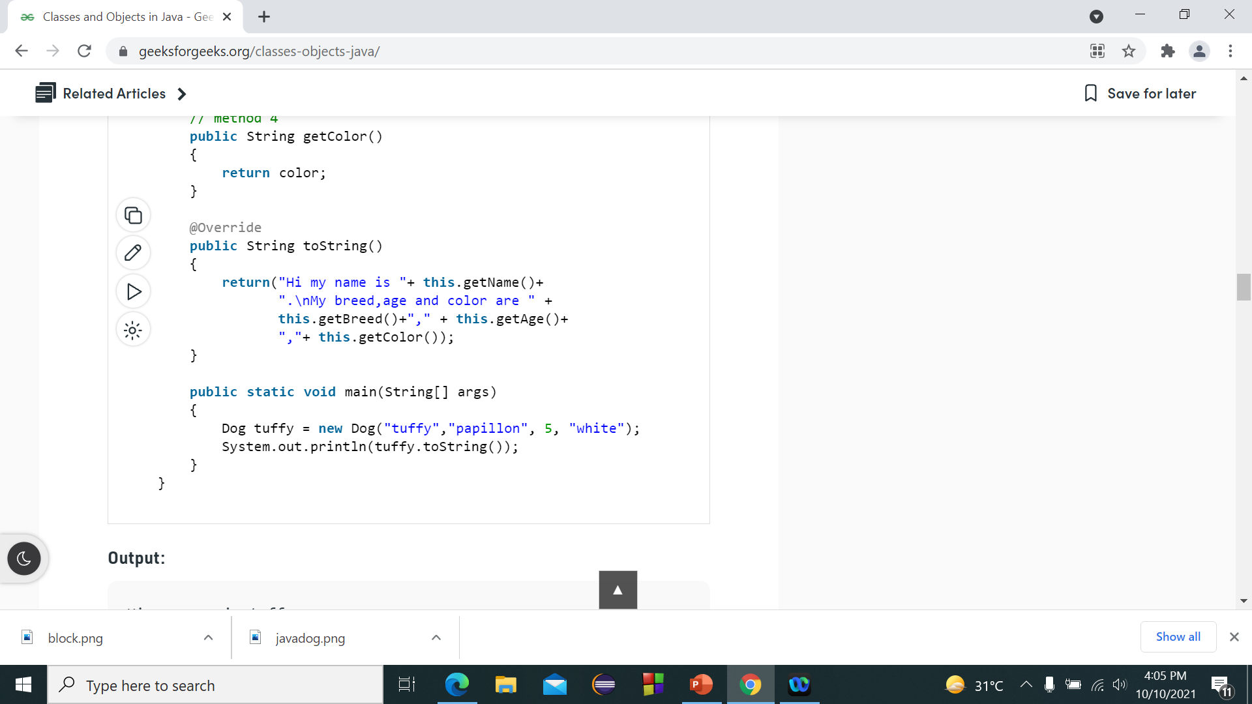
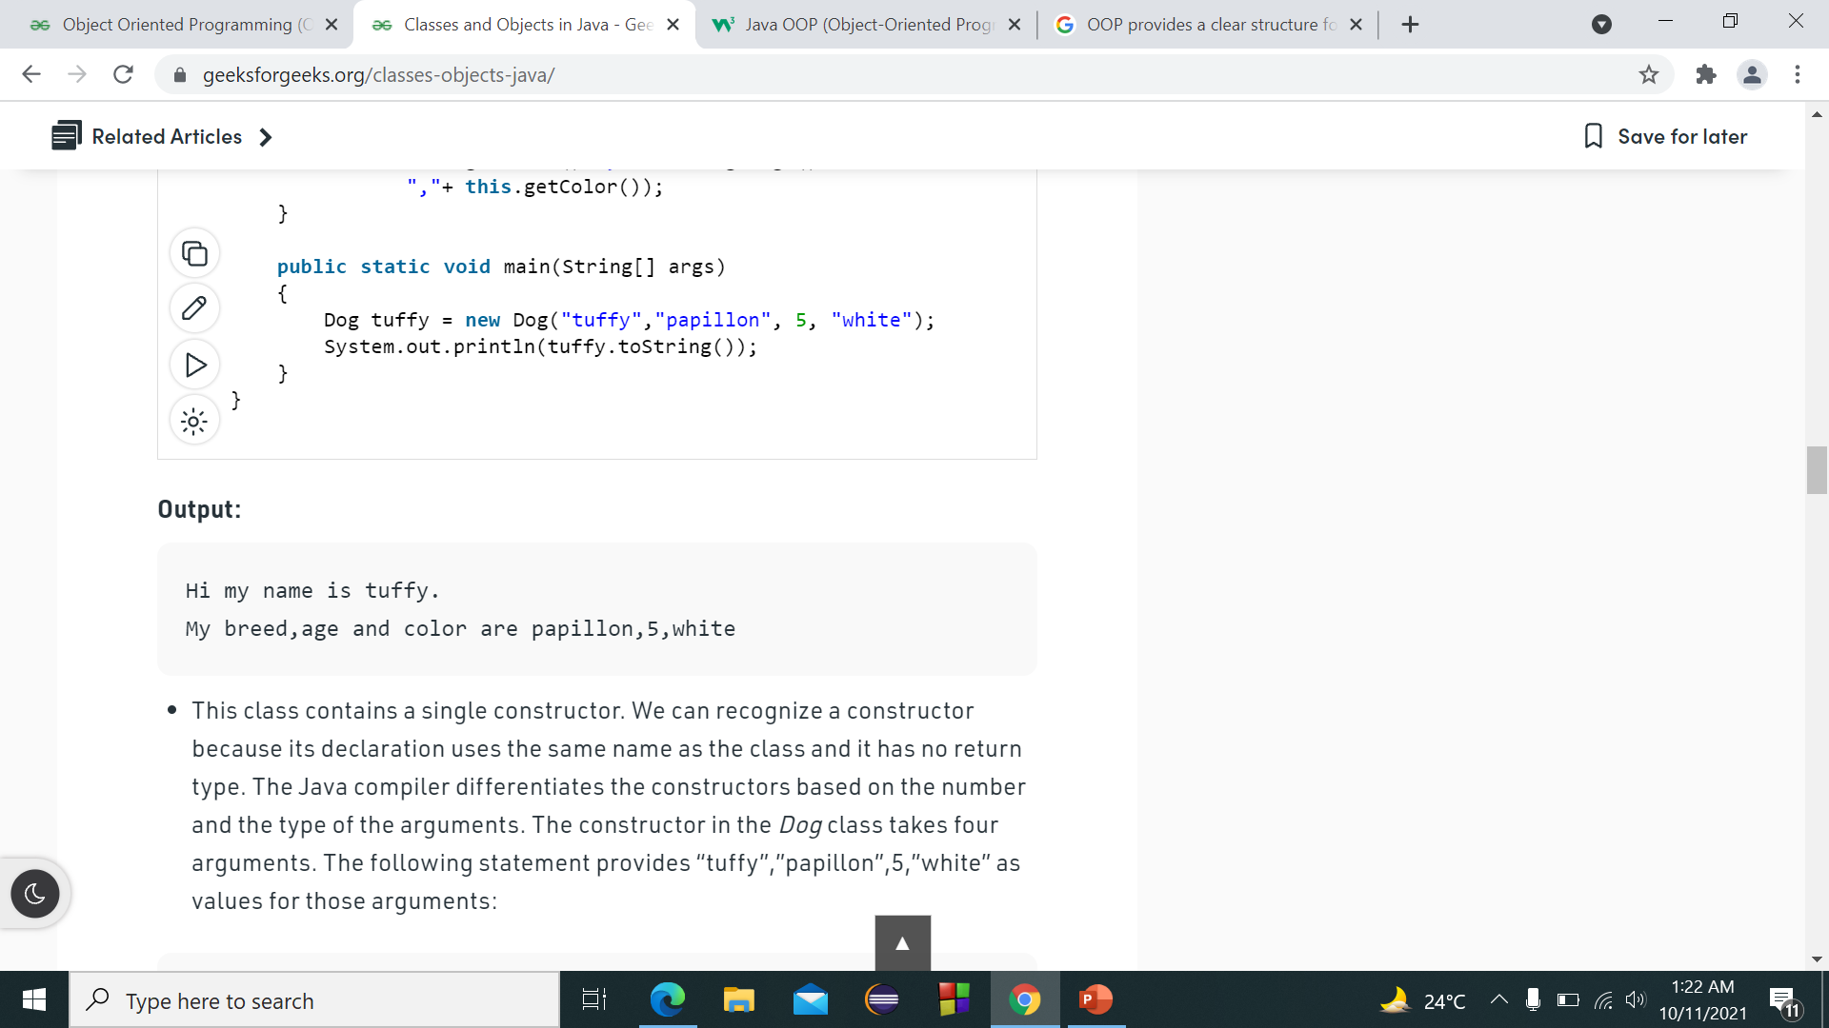
CREATING THE OBJECT

Slide 27
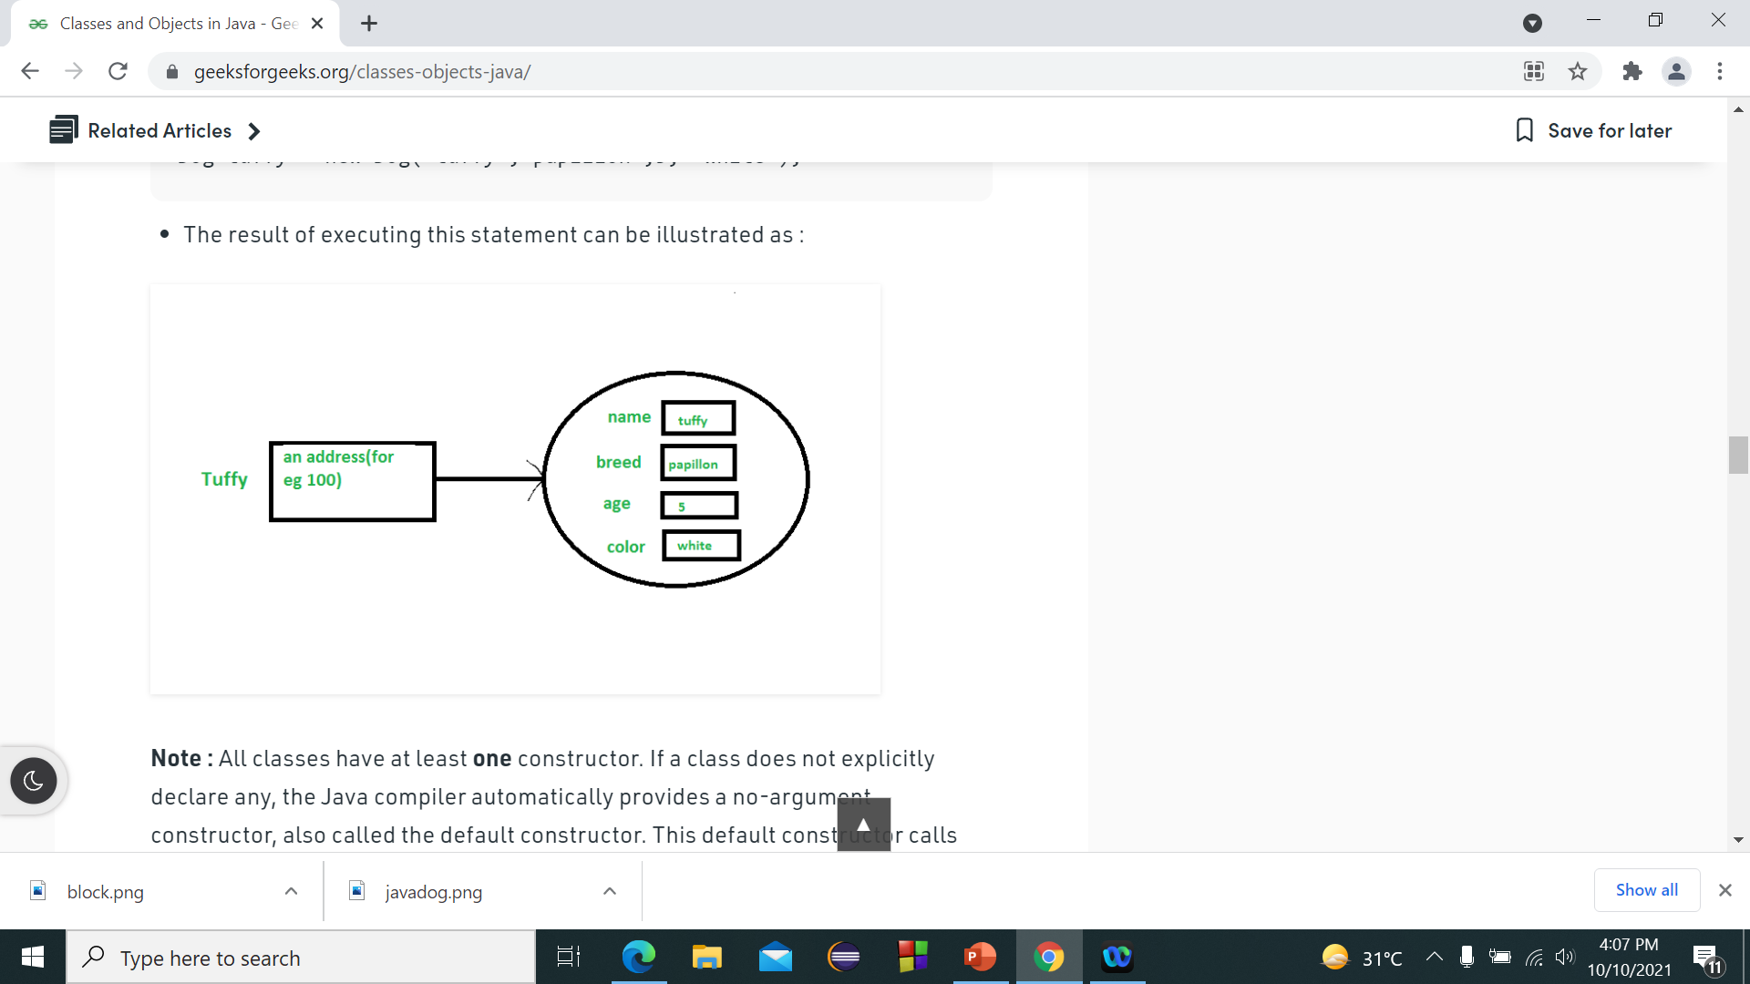
THE OBJECT

Slide 28
DEFINING METHODS
A method is a block of statements that has a name and can be executed by calling it from some other place in your program. Methods are considered members of a class.
Every program must have a method named main, which is the method first invoked when the program is run.
Dividing a complex problem: easy to understand and reusable.
There are two types of methods:
User-defined Methods: We can create our own method based on our requirements.
Standard Library Methods: These are built-in methods in Java that are available to use.

Slide 29
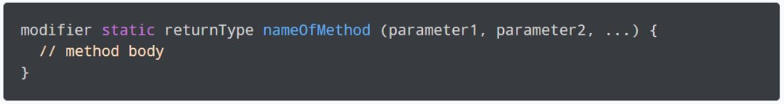
METHOD DECLARATION:
modifier: It defines access types whether the method is public, private, and so on.​
- public: Allows any other class to access the method​
- private: Hides the method from other classes​
- protected: Lets subclasses use the method but hides the method from other classes​
​
static: If we use the static keyword, it can be accessed without creating objects. The main method must always be static. ​
For e.g., the sqrt( ) method of standard Math class is static. Hence, we can directly call Math.sqrt( )
without creating an instance of Math class.​
​
returnType - It specifies what type of value a method returns. For e.g., if a method has an int return type then it returns an integer value. If the method does not return a value, its return type is void.​

Slide 30
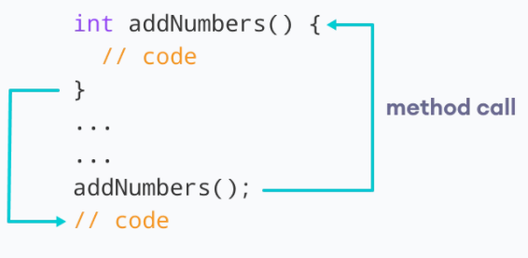
methodName - It is an identifier that is used to refer to a particular method in a program.
Can be a combination of letters and numbers but should start with a letter.
parameter1/parameter2 - These are values passed to a method. We can pass any number of arguments to a method.
method body - It includes the programming statements that are used to perform some tasks. The method body is enclosed inside the curly braces { }. The method body requires you to use the braces even if the body consists of only one statement.
Working of a Java Method Call

Slide 31
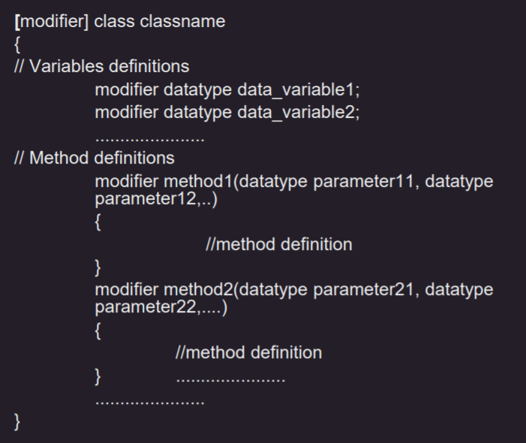
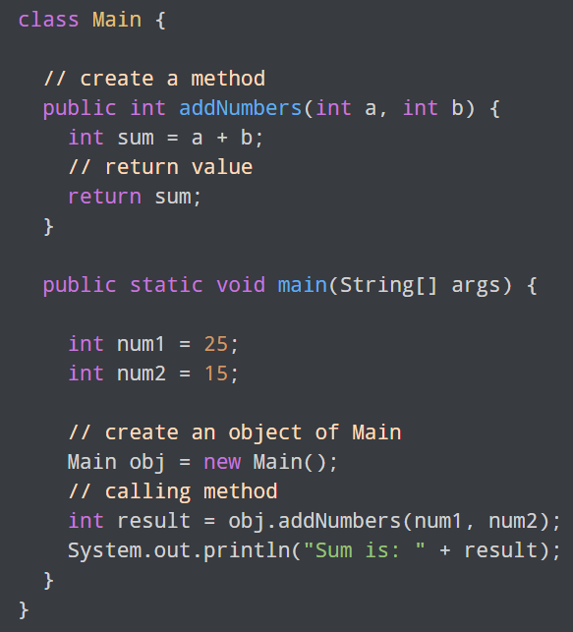
STRUCTURE OF A CLASS CONSISTING OF METHODS

Slide 32
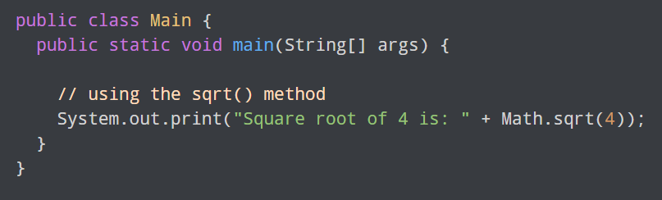
STANDARD LIBRARY METHODS
The standard library methods are built-in methods in Java that are readily available for use. These standard libraries come along with the Java Class Library (JCL) in a Java archive (*.jar) file with JVM and JRE.
For example,
print() is a method of java.io.PrintSteam. The print("...") method prints the string inside quotation marks.
sqrt() is a method of Math class. It returns the square root of a number.

Slide 33
CONSTRUCTORS AND INITIALIZATION
A constructor in Java is a special method that is used to initialize objects. It is called when an object of a class is created. It can be used to set initial values for object attributes.
If no user-defined constructor is provided for a class, compiler initializes member variables to its default values.
numeric data types are set to 0
char data types are set to null character(‘\0’)
reference variables are set to null
It has the same name as the class and it doesn't return a value, not even void.

Slide 34
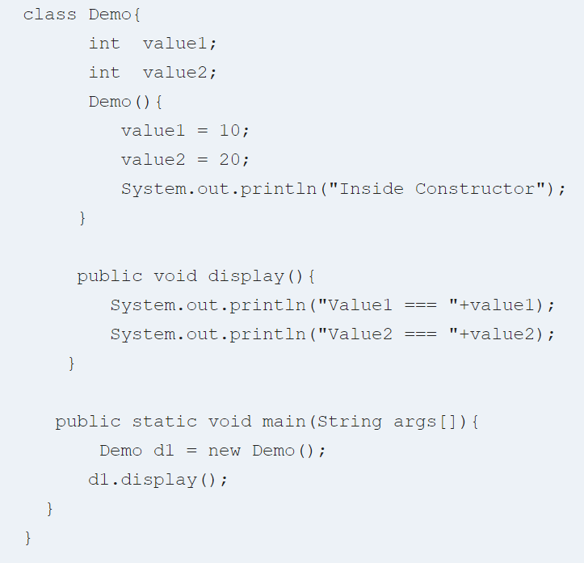
PARAMETERLESS CONSTRUCTOR

Slide 35
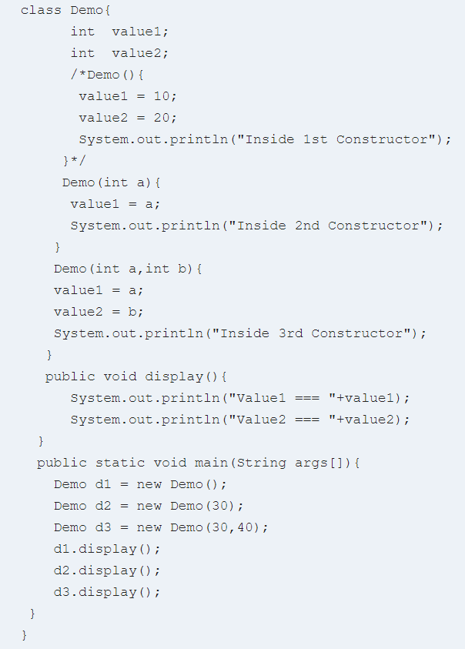
CONSTRUCTOR OVERLOADING
Java Constructor overloading is a technique in which a class can have any number of constructors that differ in parameter list.
The compiler differentiates these constructors by considering the number of parameters in the list and their type.
Every class has a default constructor in Java. Default overloaded constructor for class Demo is Demo( ). In case you do not provide this constructor, the compiler creates it for you and initializes the variables to default values. You may choose to override this default constructor and initialize variables to your desired values
But if you specify a parameterized constructor like Demo(int a) and want to use the default constructor Java Demo( ), it is mandatory for you to specify it.

Slide 36
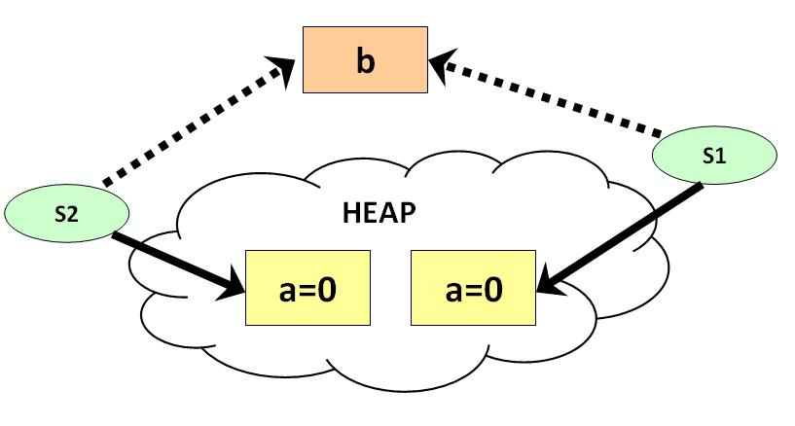
STATIC DATA MEMBERS & METHODS
Static Data Member or Static Variable :-
Static variable in Java is variable which belongs to the class and initialized only once at the start of the execution. It is a variable which belongs to the class and not to object (instance ). Static variables are initialized only once, at the start of the execution. These variables will be initialized first, before the initialization of any instance variables.
A single copy to be shared by all instances of the class.
A static variable can be accessed directly by the class name and doesn’t need any object.
Static methods can be public or private.
Syntax :- <class-name>.<variable-name>

Slide 37
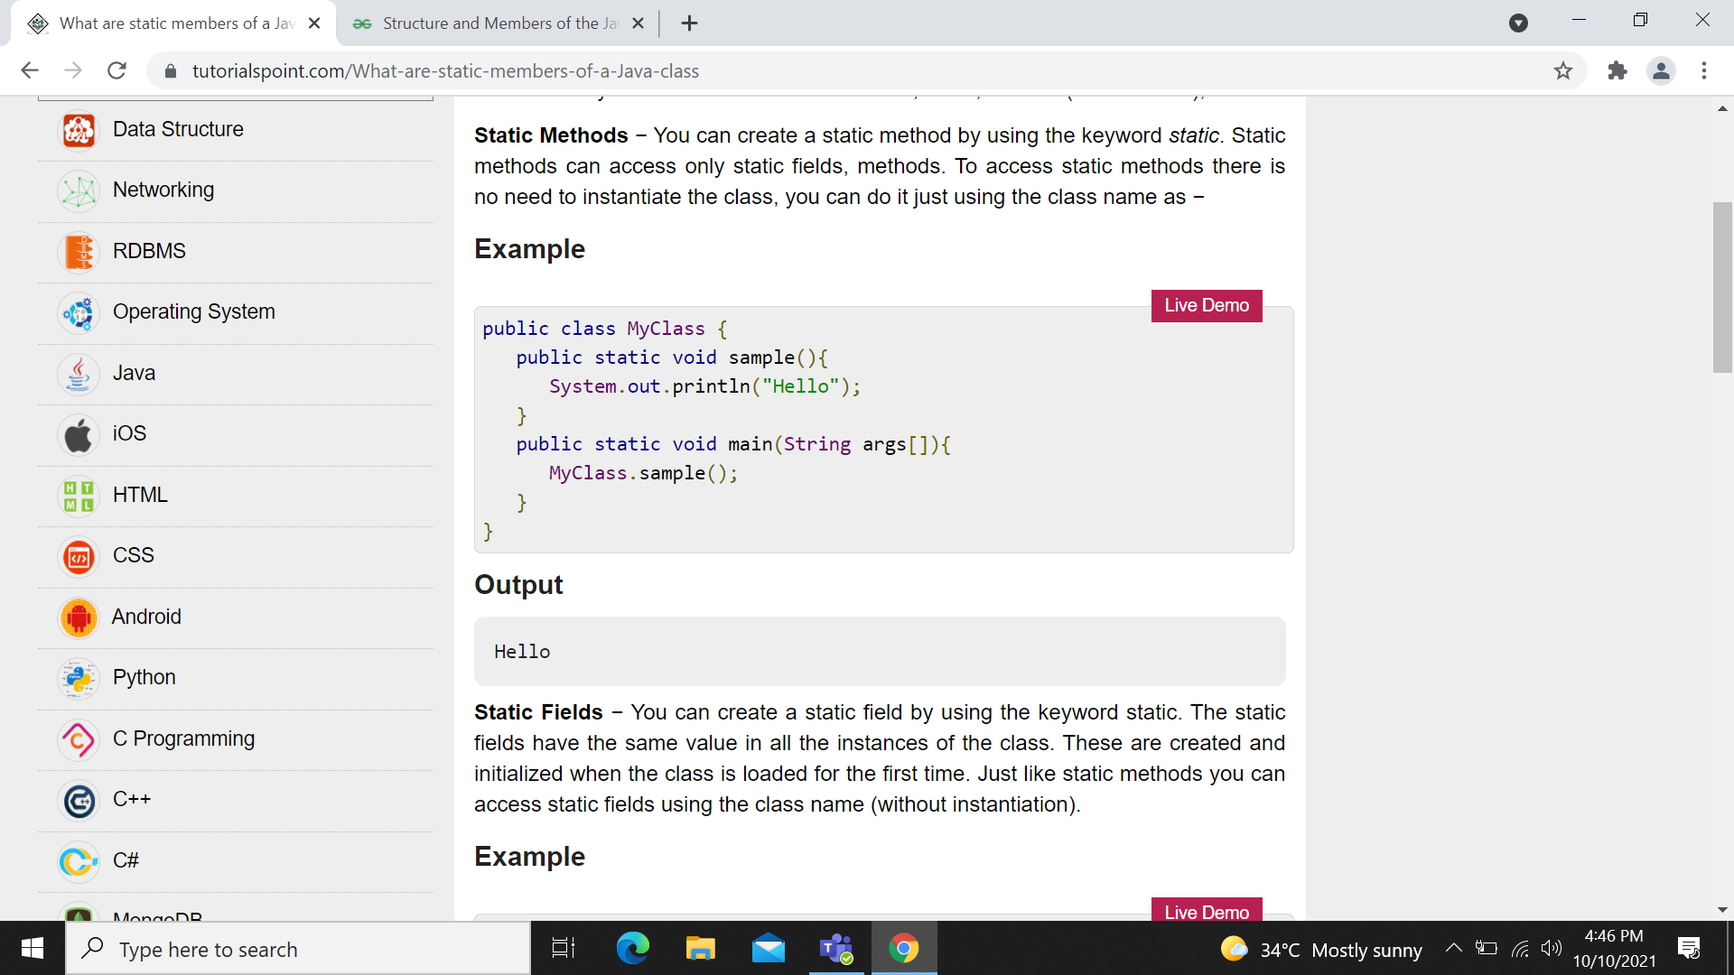
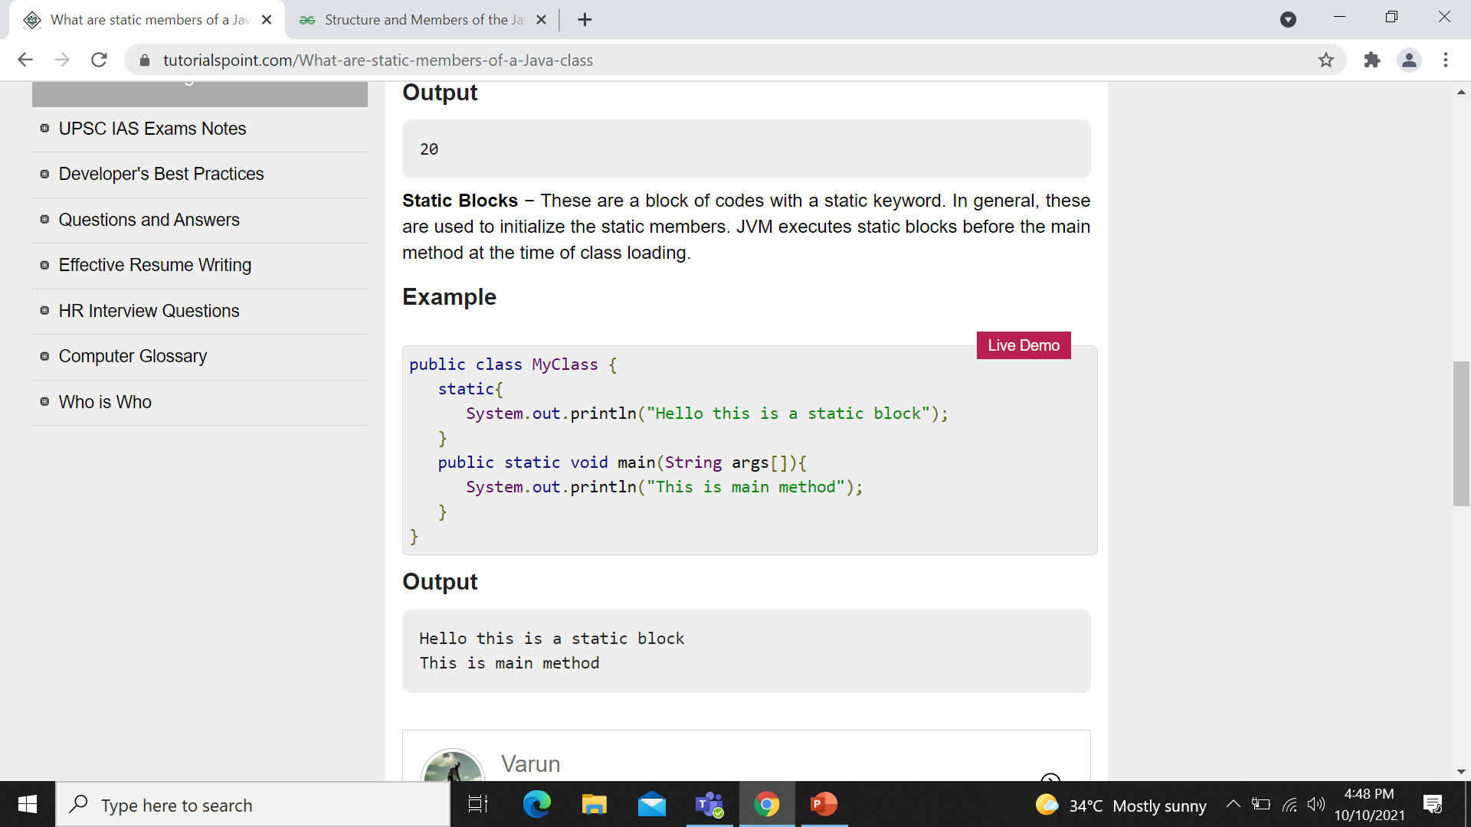
STATIC METHODS
Static methods are used to perform single operation like opening the files, obtaining a DBMS connection etc.
A static method can call only other static methods and can not call a non-static method from it.
Static methods can access static data member and can change the value of it.
A static method can be accessed directly by the class name and doesn’t need any object
A static method cannot refer to “this” or “super” keywords in anyway

Slide 38
REFERENCE VARIABLE CASTING
Casting is the conversion of data of one type to another type either implicitly or explicitly.
Casting happens for both primitive types and reference types.
If the casting operation is safe, java will do automatic type casting. This is called implicit type casting.
If java can't be sure whether the casting will be safe, java will not do automatic casting, but programmer can do the casting if he is sure about the outcome. This is called explicit type casting.
Both types should be compatible in both implicit and explicit casting. We cannot cast two unrelated classes implicitly or explicitly.

Slide 39
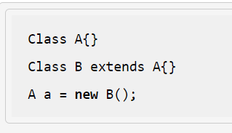
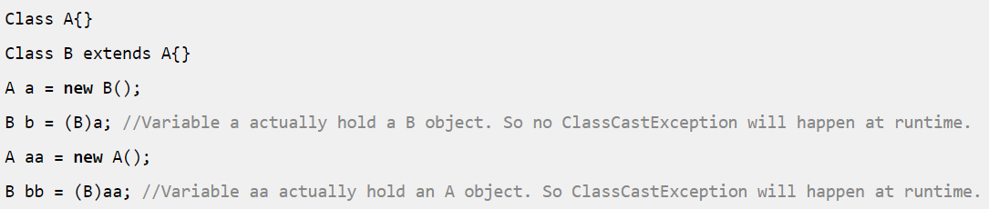
Automatic type casting for reference types :-
In case of reference types, a child object or child reference variable can be assigned to a parent reference variable.
Parent can be a class, abstract class or interface.
Explicit type casting for reference types
The types should be compatible for both implicit and explicit casting.
In case of reference types, when we assign a child type object to a parent type, no explicit cast is required.
When assigning a parent type variable to child type variable, an explicit cast is required. However, you need to make sure that the parent type reference variable is referring to a child object; else you will get a ClassCastException at runtime.

Slide 40
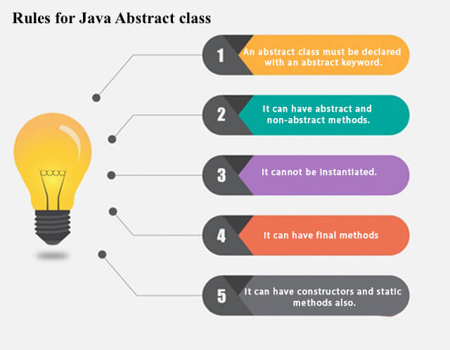
ABSTRACT CLASSES
A class which is declared by keyword abstract is known as an abstract class.
It can have abstract and non-abstract methods.

Slide 41
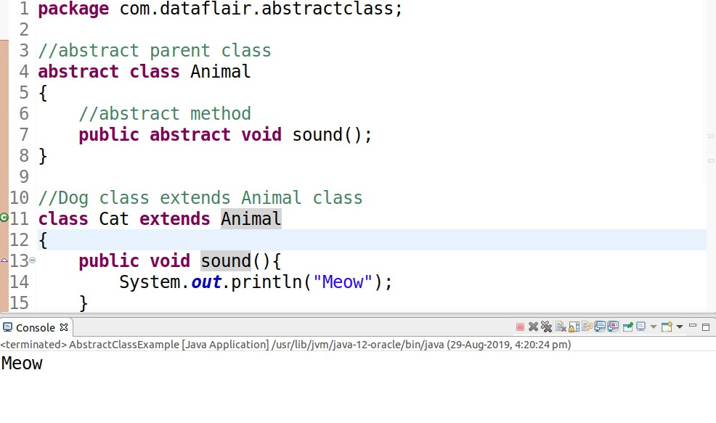
Abstract Method in Java
A method which is declared by keyword abstract and does not have implementation is known as an abstract method.
Example of Abstract class

Slide 42
INTERFACE
Interfaces specify what a class must do and not how.
It is the blueprint of the class.
There can be only abstract methods in the Java interface, not method body
It is used to achieve abstraction and multiple inheritance in java.
Syntax:-
interface <interface_name>
{
// declare constant fields
// declare methods that abstract
// by default.
}

Slide 43
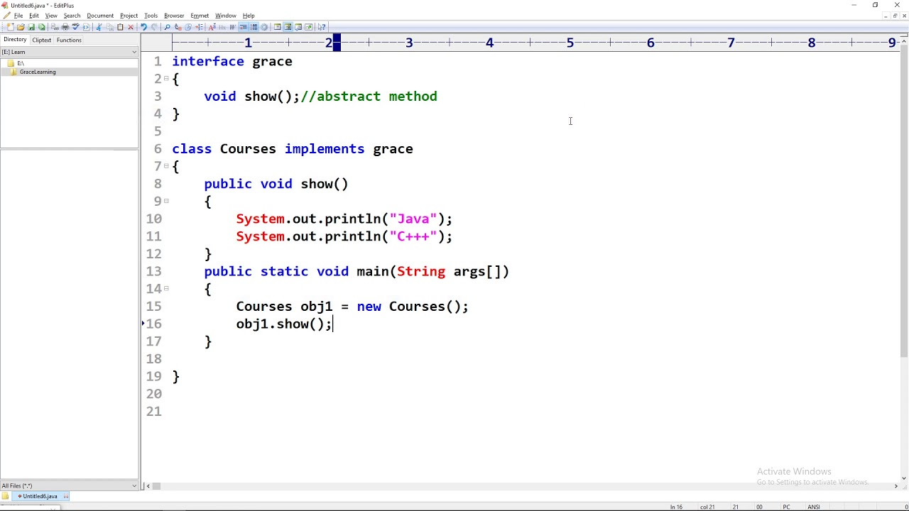
Example of Interface

Slide 44
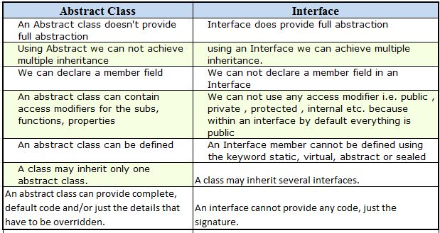
Difference between Abstract class and Interface

Slide 45
REFERENCES
geeksforgeeks.org
w3schools
Defining Methods
Types of Methods
What are constructors?
Constructor Overloading

Slide 46
THANK YOU.

